Slide 1
Graph Neural Network

Slide 2

What’s a GNN?
MLP
(Fully Connected layers)
Tabular data
CNN
Image data
GNN
Graph
GNN is a model that can perceive graphs as input.

Slide 3
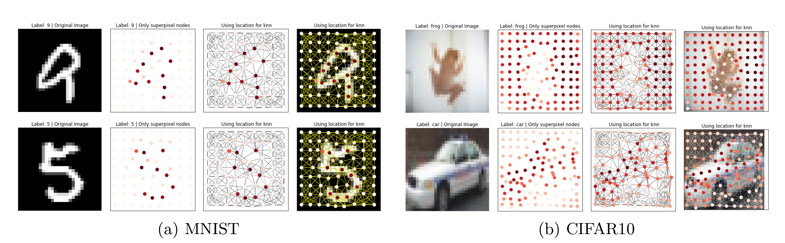


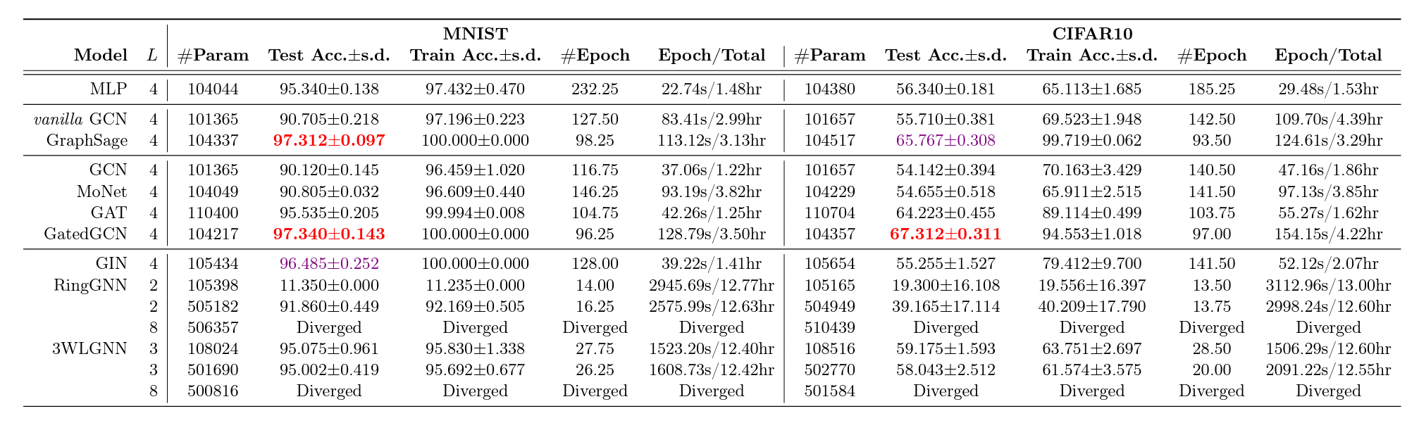
Using GNN for image classification
Benchmarking Graph Neural Networks
GNN

Slide 4










Two operations are used in GNN
Aggregation: use the neighbours and itself to generate next hidden state.
Readout: generate a representation for the fully graph.
Aggregation
Readout
Nothing special, still linear algebra but considering the nodes around.

Slide 5


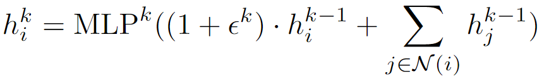


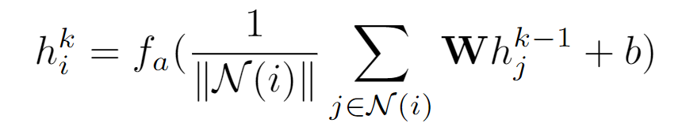
Aggregation (feedforward in GNN)
Sum, NN4G (2009)
Step-sum, DCNN
2nd hidden Layer
LSTM & Max-pool, GraphSAGE
Attention, GAT
Aggregation:
1st hidden layer
GIN provides theoretical algorithm
Embedding:
GCN is a spectral-based method.
Input layer

Slide 6

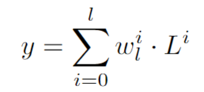
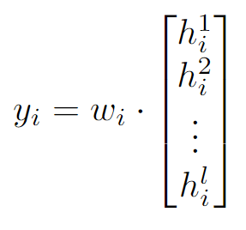
Readout:
Global, NN4G (2009)
Node, DCNN
The nodes in each layer are seen as a vector,
Node feature:

Slide 7
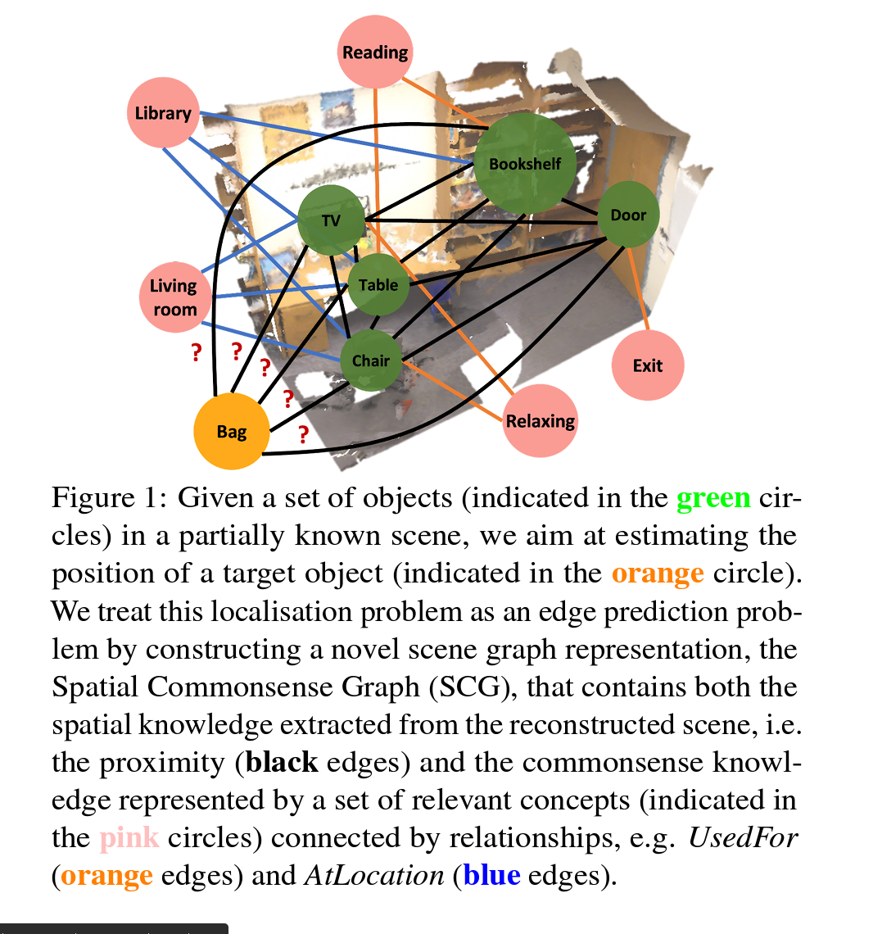
Spatial Commonsense Graph for Object Localisation in Partial Scenes

Slide 8
Why it is not applicable to our work?
The GNN is used to process graphs. Our CXRs can be transformed into graphs, but it will damage performance, as demonstrated previously.
The clinical data is tabular data, which can’t be converted into graphs.
It’s an architecture for processing graphs or even outputting graphs (graph generator); however, we do not use this data structure in our work. The only approach I can think of is to replace MobileNetv3 with GNN, which would make the image backbone a GNN. In this method, the CXRs have to be transformed into graphs, and we can expect the performance drop as previously seen in the CIFAR10 and MNIST evaluations. This will not improve our understanding of the interaction between modalities.

